Slide 1
Diverse Cropping Systems for
Natural Farming WASSAN
8th March. 2022
wassanmail@wassan.org

Slide 4
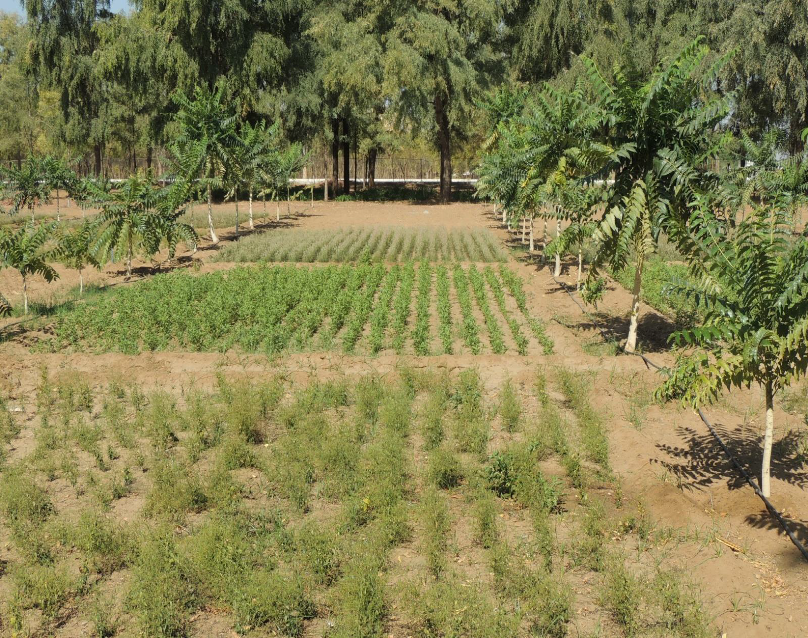
Agroforestry
Source: CEEW

Slide 5
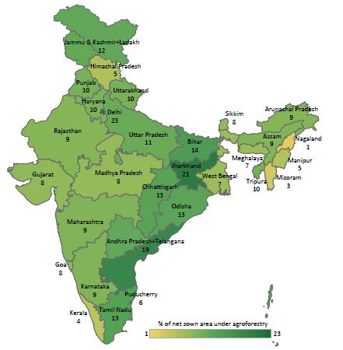
Statewise area
Coverage:agroforestry
Source: Newaj et al 2017
CEEW

Slide 6
Agroforestry Systems
Agri-silivculture
Agri-horticulture
Agri-sylvi-horticulture
Agri-silvi-pasture
Boundary plantation
Block Plantation
Energy Plantation
Alley Cropping
Silvi-olericulture
Horti-pasture
Horti-olericulture
Sylvi-pasture
Forage Forestry
Shelter belts
Wind-breaks
Live fence
Silvi or Horti-sericulture
Horti-apiculture
Aqua-forestry
Homestead
25 Mill Ha in 15 agroclimatic zones Source: http:/cafri.res.in/

Slide 7
Agroecological Synergies in Agroforestry
Diversity
Knowledge co-creation and sharing
Synergies
Efficiency
Recycling
Resilience
Human and Social Values
Culture and Food Traditions

Slide 8
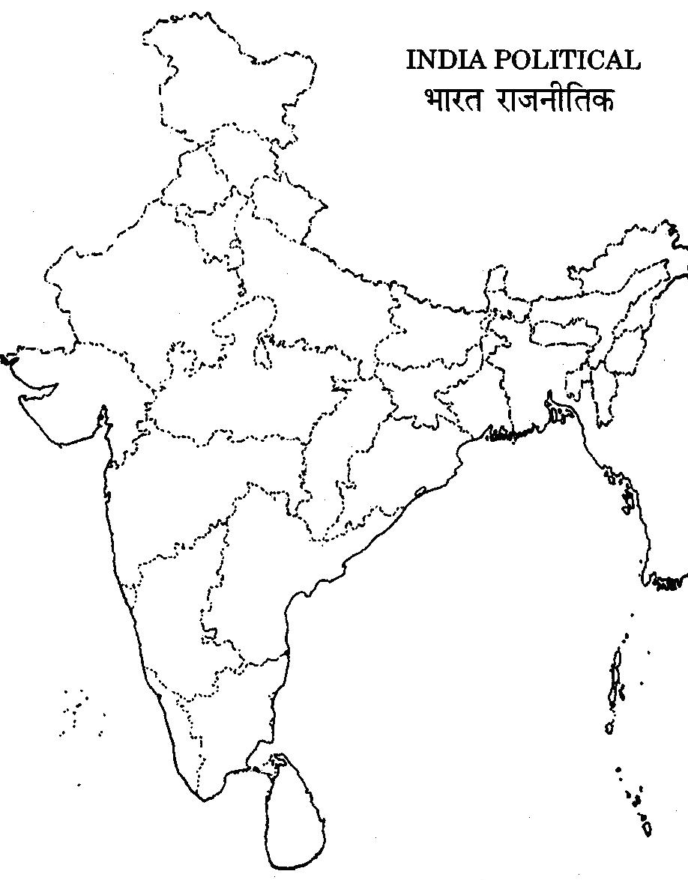
Indiginous Multi- Cropping Systems
Hangadi Kheti, Udaipur,
Rajasthan
Kurwa, Rajmahal Plateau,
Jharkhand
Olya/Chat, Dewas,
Madhya Pradesh
Rammol, Kachchh,
Gujarath
Baradhanya, Pune,
Maharashtra
Sat-Gajara, Hoshangbad,
Madhya Pradesh
Akkadi Saalu, Riachur & kolar, Karnataka
Pata, Wardha,
Maharashtra
Ponamkuthu, Wayanad,
Kerala
Misa Chasa, Koraput,
Odisha
Puradiyakrishi & Punam Krishi, Idukki, Kerala
Navadhanya, Ananthpur,
Andhra Pradesh
Source: Documenting Mixed Indigenous cropping Systems’ Features and design (DeMISteFi): RRAN Partner NGOs and Individual Researcher

Slide 9
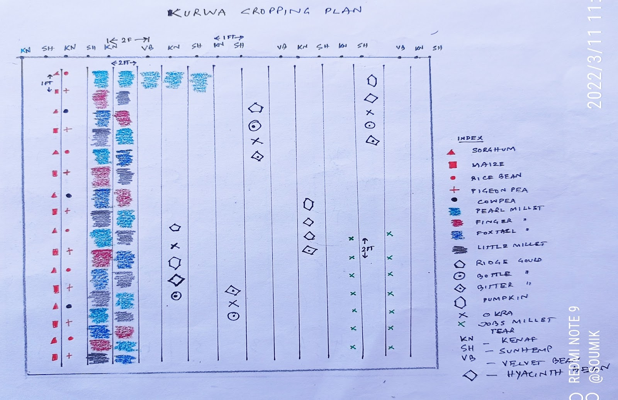
Kurwa Cropping Systems - Jharkhand

Slide 10
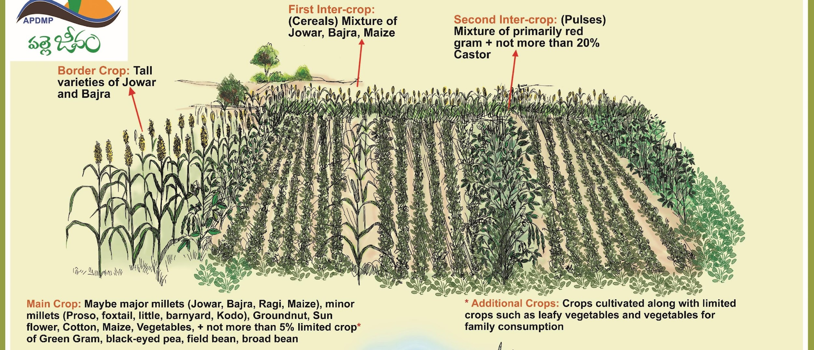
Navadhanya Cropping Systems - AP

Slide 11
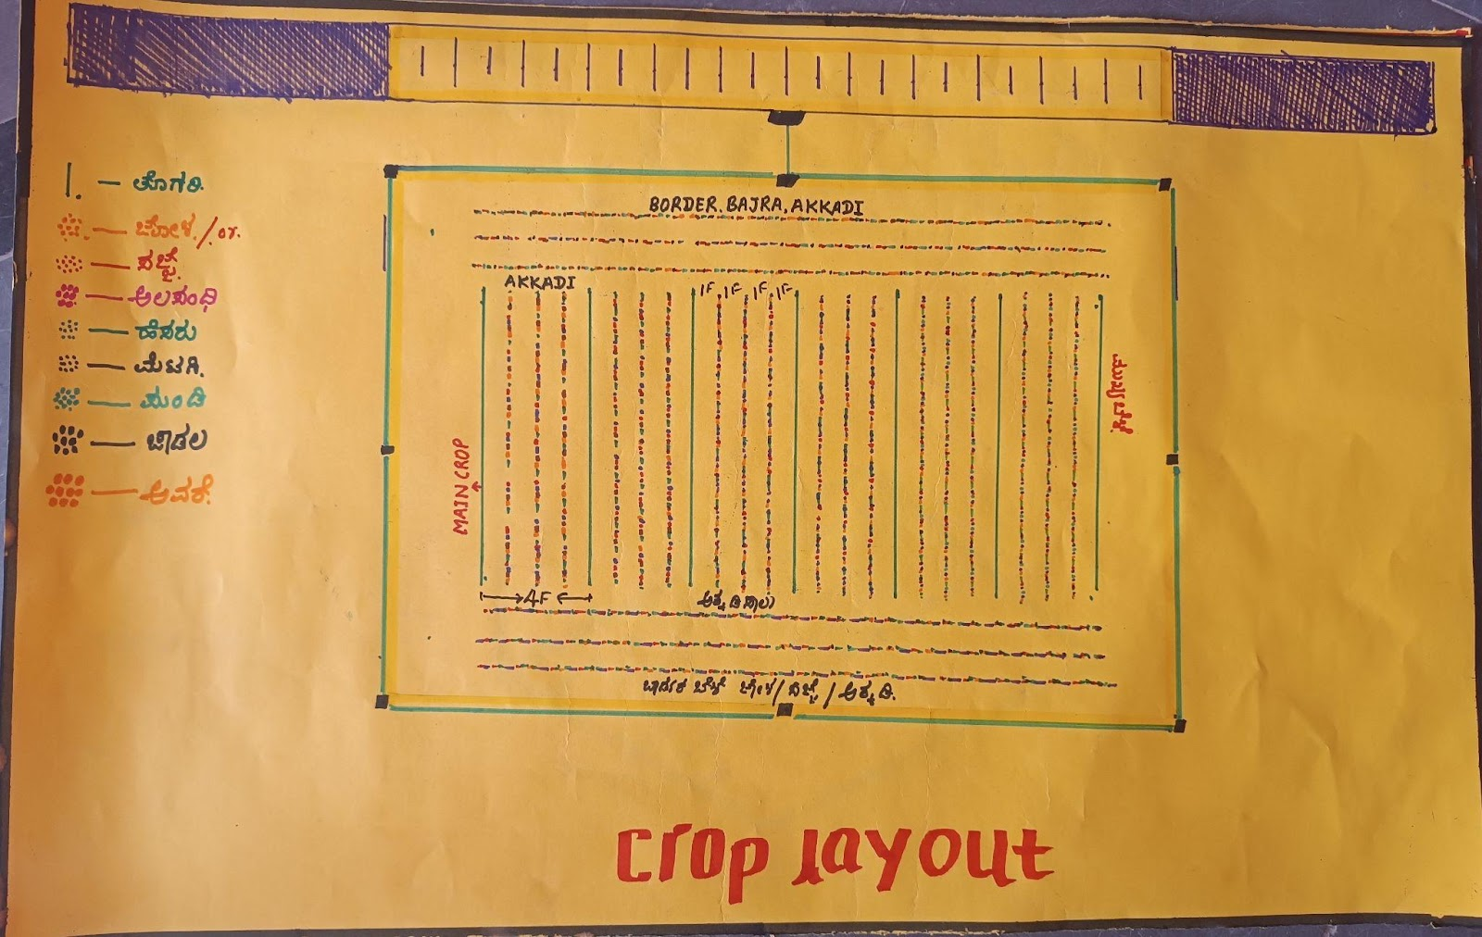
Akkidi Saalu, Raichur, Karnataka

Slide 12
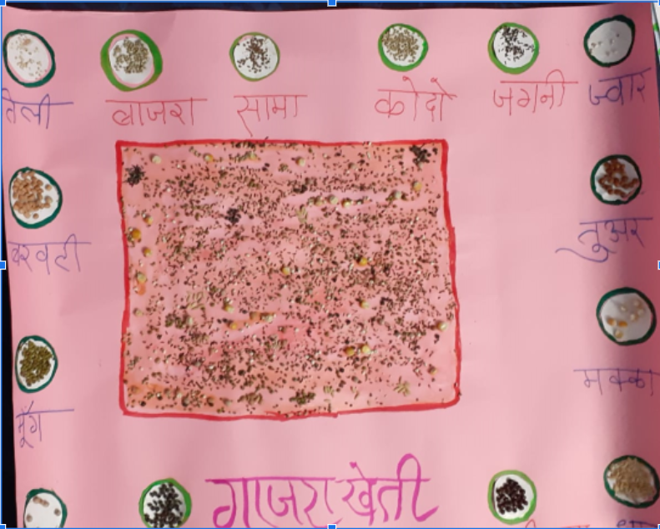
SatGajra / Utera Kheti – MP

Slide 13
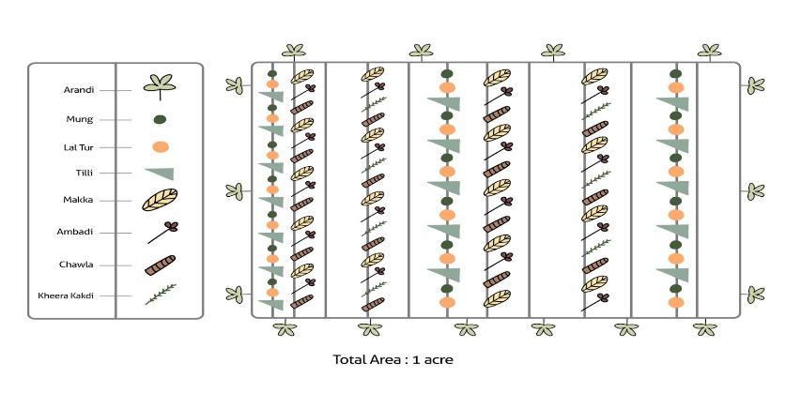
Olya Cropping Systems – Dewas, Madhya Pradesh
Source: Documenting Mixed Indigenous cropping Systems’ Features and design (DeMISteFi): Rithesh and Team (SPS)

Slide 14
Puryadakrishi - Kerala

Slide 15
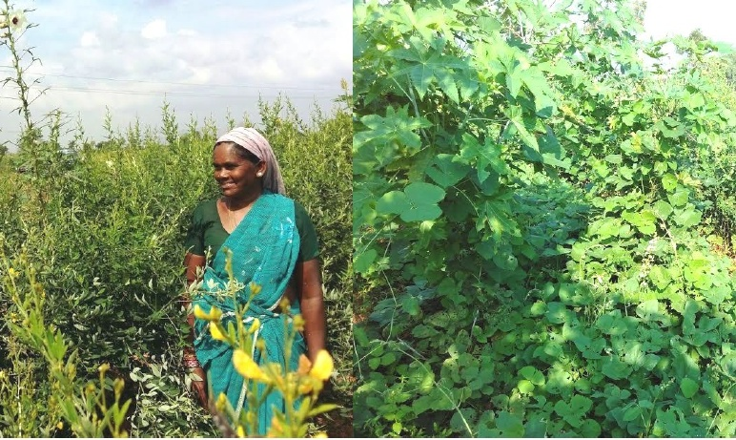
NAVADHANYA SYSTEM OF CROPPING
Traditional System of Cropping in the Drylands of Anantapuramu
Crop canopy in January in Anantapuramu in drylands.

Slide 16
Location Specific Design
Soil (type, depth & topography)
Rainfall (amount and distribution)
Temperature (soil, canopy and air);
Sun light harvest (multi tier/ layer)
Relative Humidity (capturing moisture-soil & air)
FS needs (animal, fish, poultry) Food, feed & other local needs and preferences

Slide 17
Why Diverse? System Benefits
One time Sowing & Multiple Harvests
Crop harvests starts from Sept-Oct and continues upto February
Soil is covered till February/ March by crops
Soil will not be exposed to the sun for 9 to 10 months and heavy leaf-litter addition to soil improving quality of soil over time.
Crops are designed in a way that Multi-tiered Canopy at different points in time uses every inch of sunshine and land over a period 9 months.
Makes use of most of the rainfall (SW and NE monsoons and Dew); NE monsoon rainfall is otherwise not used in single rainfed crops.
Pollinators (birds, insects diversity) & Circular - Give and take ... other benefits.

Slide 18
Why Diverse? - Soil Benefits - Physical
Bulk density
Porosity
Infiltration rate
Moisture holding capacity
Aeration
Erosion
surface runoff
Interrelated

Slide 19
Why Diverse? - Soil Benefits
Nutrient
Mobility
Dynamics,
Solubilisation (P and K)
Enrichment (N and micro)
Interaction compatibility (Ca, Zn, Fe)
Demand-supply dynamics adjusted to CS needs
NUE, Efficient use of available nutrients, Leaching
pH balance
Nutrient harvest at different depths

Slide 20
Why Diverse? Biological
Crop based microbial diversity
Fungal: bacteria ratio
Mycorrhizal role
Solubilising bacteria
Pest antagonists
Micro: (Psuedomonas, Bacillus, Trichoderma, entomopathogenic)
Macro:Earthworms, Beneficial insects, Bees

Slide 21
Why Diverse? - Crop-Water Relations
Source shift based on seasonal availability (Rainy and Post Rainy)
Capturing air moisture (Chickpea- leaf surface)
Temperature gradient - Evaporation Evapotranspiration
Stomatal and root depth and absorption mechanisms in diverse crops
Subsoil water capturing, Soil adsorption

Slide 22
Navadhanya Cropping Systems – Case Study
Main crop: groundnut/ millets/ sunflower etc. harvested in <100 days (3 months)
1st Intercrop Row harvested in 4 months
2nd Intercrop Row: harvested in 6 months
Border crop: Millets on border rows
Limited crops: mixed within the rows along with the first 3 -- small propotions – a diverse array of crops for self consumption or sale.
Additional crops: leafy vegetables, vegetables and others – very small niches mainly for household consumption

Slide 23
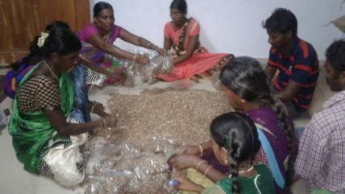
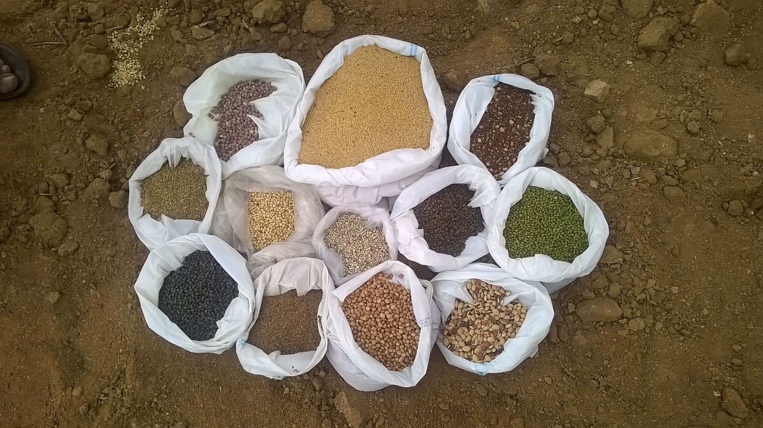
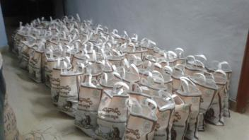
Seeds of Navadhanya Cropping Systems

Slide 24
4 Dimensional Agriculture Design
నవధాన్య
May June july Aug Sept Oct Nov Dec Jan Feb Mar Aprl
Time
Height
Length
5 to 10 crops
Width
G x E x D x M
Genetics x Environment x Design x Management

Slide 25
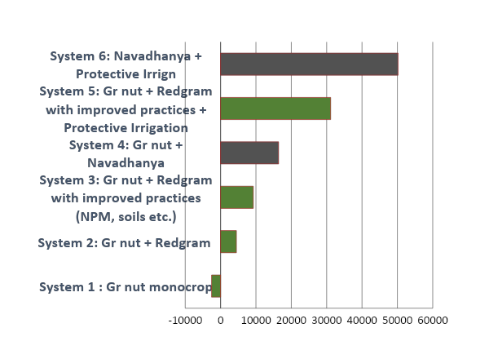
Comparative Net Returns of Navadhanya
నవధాన్య
+ prot Irrign
With protective irrigation
నవధాన్య
Net Returns Rs. per acre

Slide 26
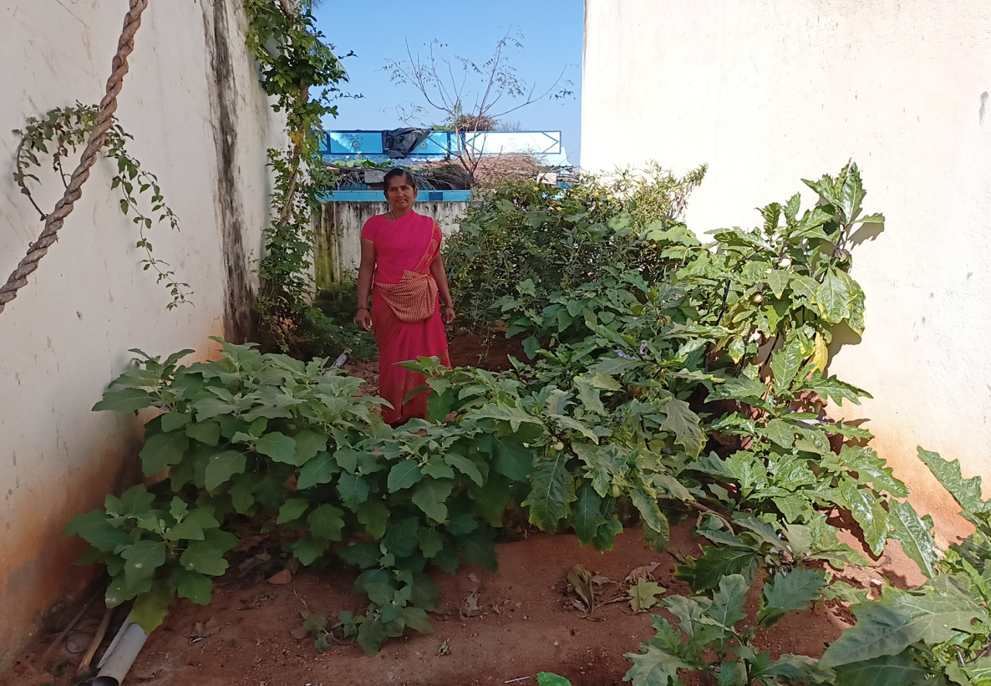
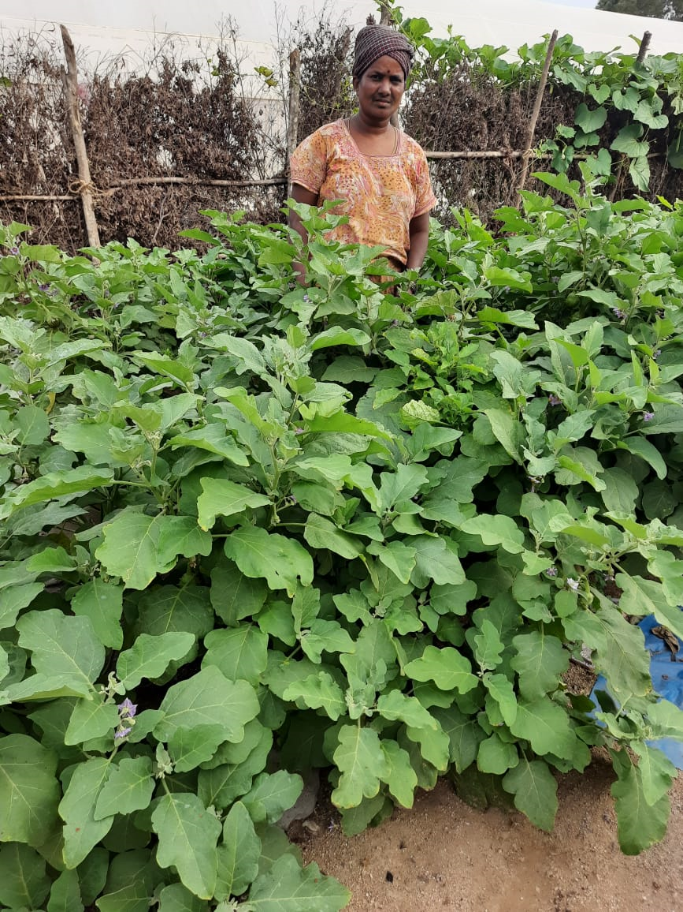
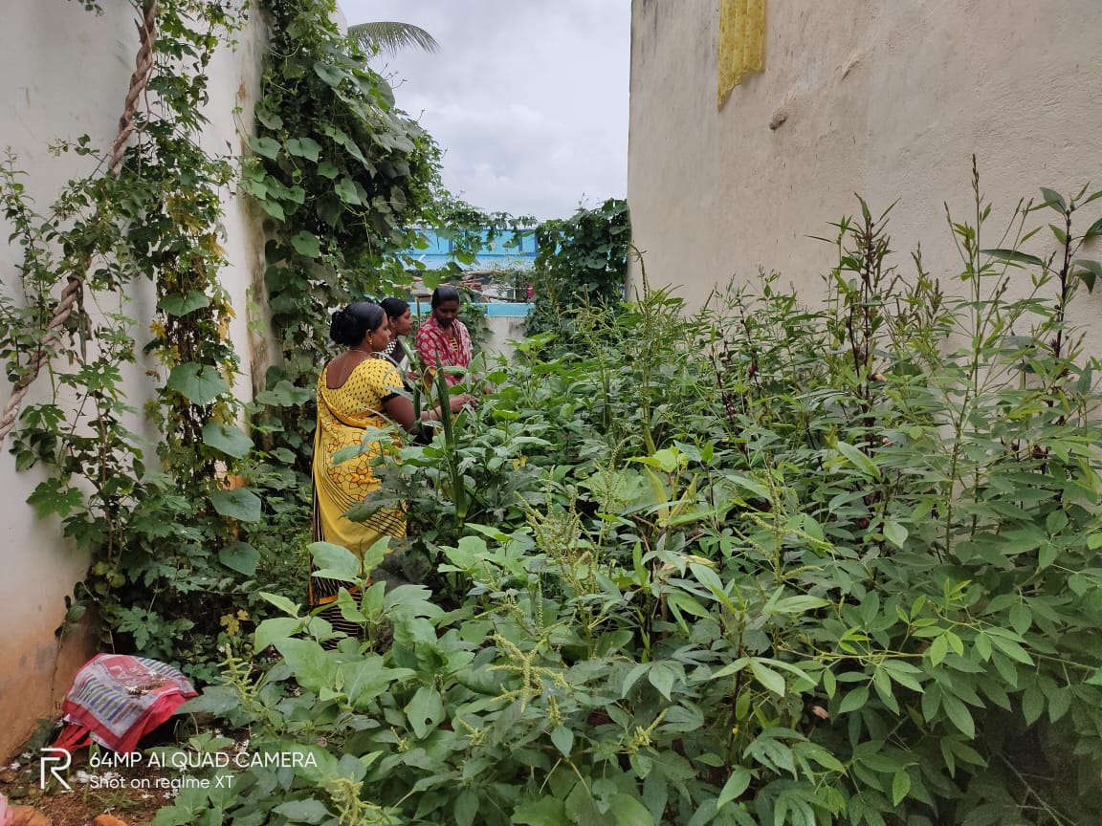
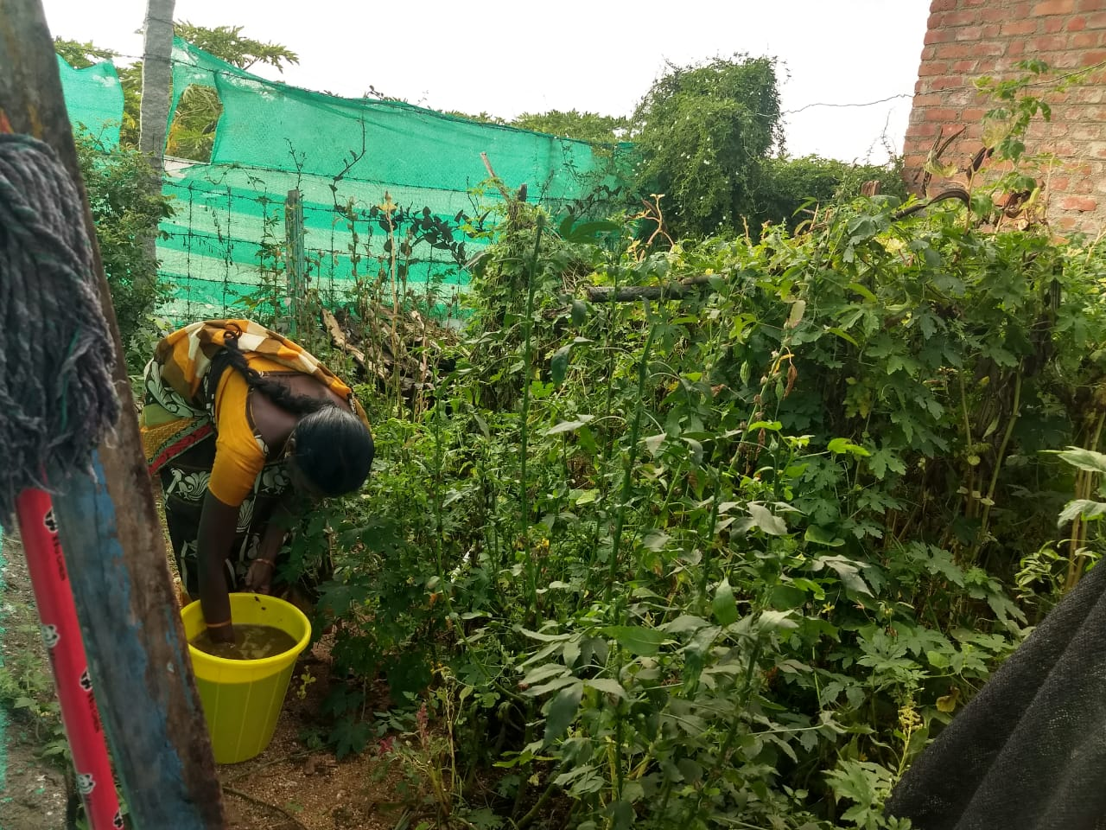
Poshan Gardens

Slide 27
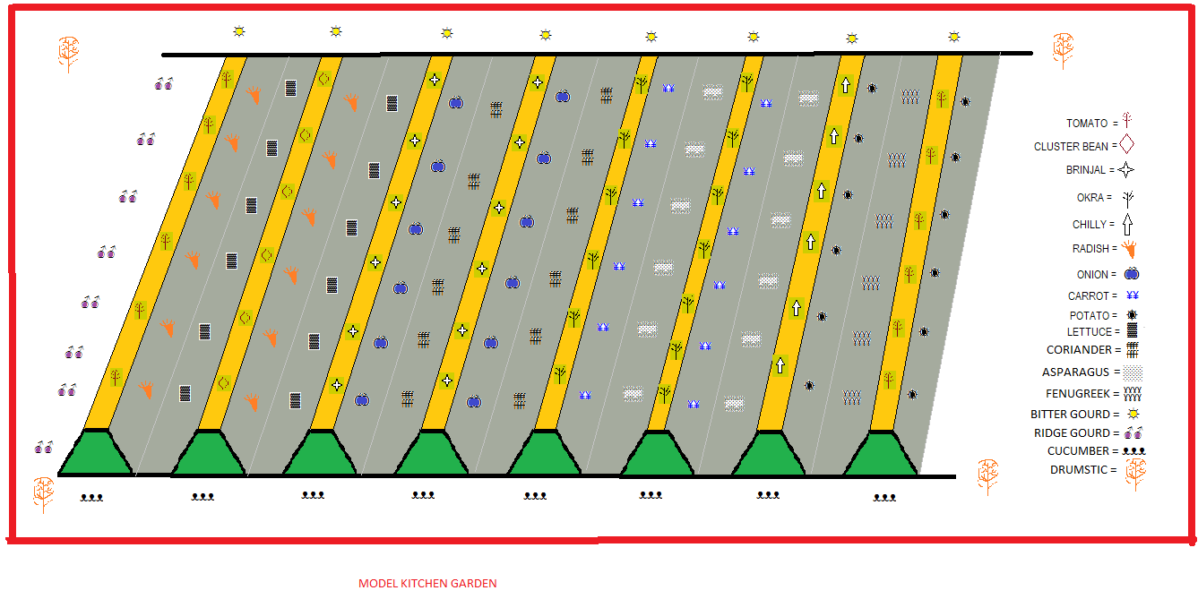
Poshan Garden- Layout for 1 cent of land

Slide 28
Yield Estimation for 1 cent of land
Sl.No | Type of plants | Rows | No of plants | Units | Yeild per plant (Kgs/bundels) | Total Yeild (Kgs/Bundels | 1st Month | 2nd month | 3rd Month | 4th Month | 5th Month | 6th Month | 7th Month | 8th Month | 9th Month | 10th Month | 11th Month | 12th Month
 | Vegitables
1 | Tomato (టమోటా ) | 2 | 42 | Kgs | 3 | 126 |  |  | * |  |  | *
2 | Cluster bean (గోరు చిక్కుడు) | 1 | 21 | Kgs | 4 | 84 |  | * |  | *
3 | Brinjal ( వంగ ) | 2 | 42 | Kgs | 3 | 126 |  |  | * |  |  |  |  |  |  | *
4 | Chilly (మిరప) | 1 | 21 | Kgs | 1.5 | 31.5 |  |  | * |  |  |  |  |  |  |  |  | *
5 | Okra ( బెండ) | 2 | 42 | Kgs | 4 | 168 |  | * |  |  |  | *
 | Tubers//manioc
6 | Radish (ముల్లంగి) | 2 | 62 | Kgs | 0.15 | 9.3 |  | *
7 | Onion (ఉల్లిపాయలు) | 2 | 62 | Kgs | 0.1 | 6.2 |  |  | *
8 | Carrot (క్యారెట్ ) | 2 | 62 | Kgs | 0.05 | 3.1 |  |  |  | *
9 | Potato (బంగాళదుంప) | 2 | 62 | Kgs | 1 | 62 |  |  | * |  |  |  | *
 | Green Leafy
10 | Lettuce (పాలకూర ) | 2 | 62 | Bundal | 20 | 1240 |  | * |  |  |  |  | *
11 | Coriander (కొత్తిమీర) | 2 | 62 | Bundal | 1 | 62 |  | *
12 | Asparagus ( తోటకూర) | 2 | 62 | Bundal | 100 | 6200 |  | *
13 | Fenugreek (మెంతికూర) | 2 | 62 | Bundal | 2 | 124 |  | *
14 | Mint (పోదీన) | 2 | 62 | Bundal | 60 | 3720 |  | * |  |  |  |  |  |  |  |  |  | *
 | Creepers
15 | Bitter Gourd (కాకర) | 1 | 21 | Kgs | 5 | 105 |  |  | * |  |  | *
16 | Ridge gourd (బీర) | 1 | 21 | Kgs | 10 | 210 |  |  | * |  |  | *
17 | Cucumber (కీర దోస) | 1 | 21 | Kgs | 8 | 168 |  |  | * |  |  | *
 | Fruit plants
18 | Drumstic | 0 | 4 | Kgs | 25 | 100 |  |  |  |  |  | * |  |  | *

Slide 29
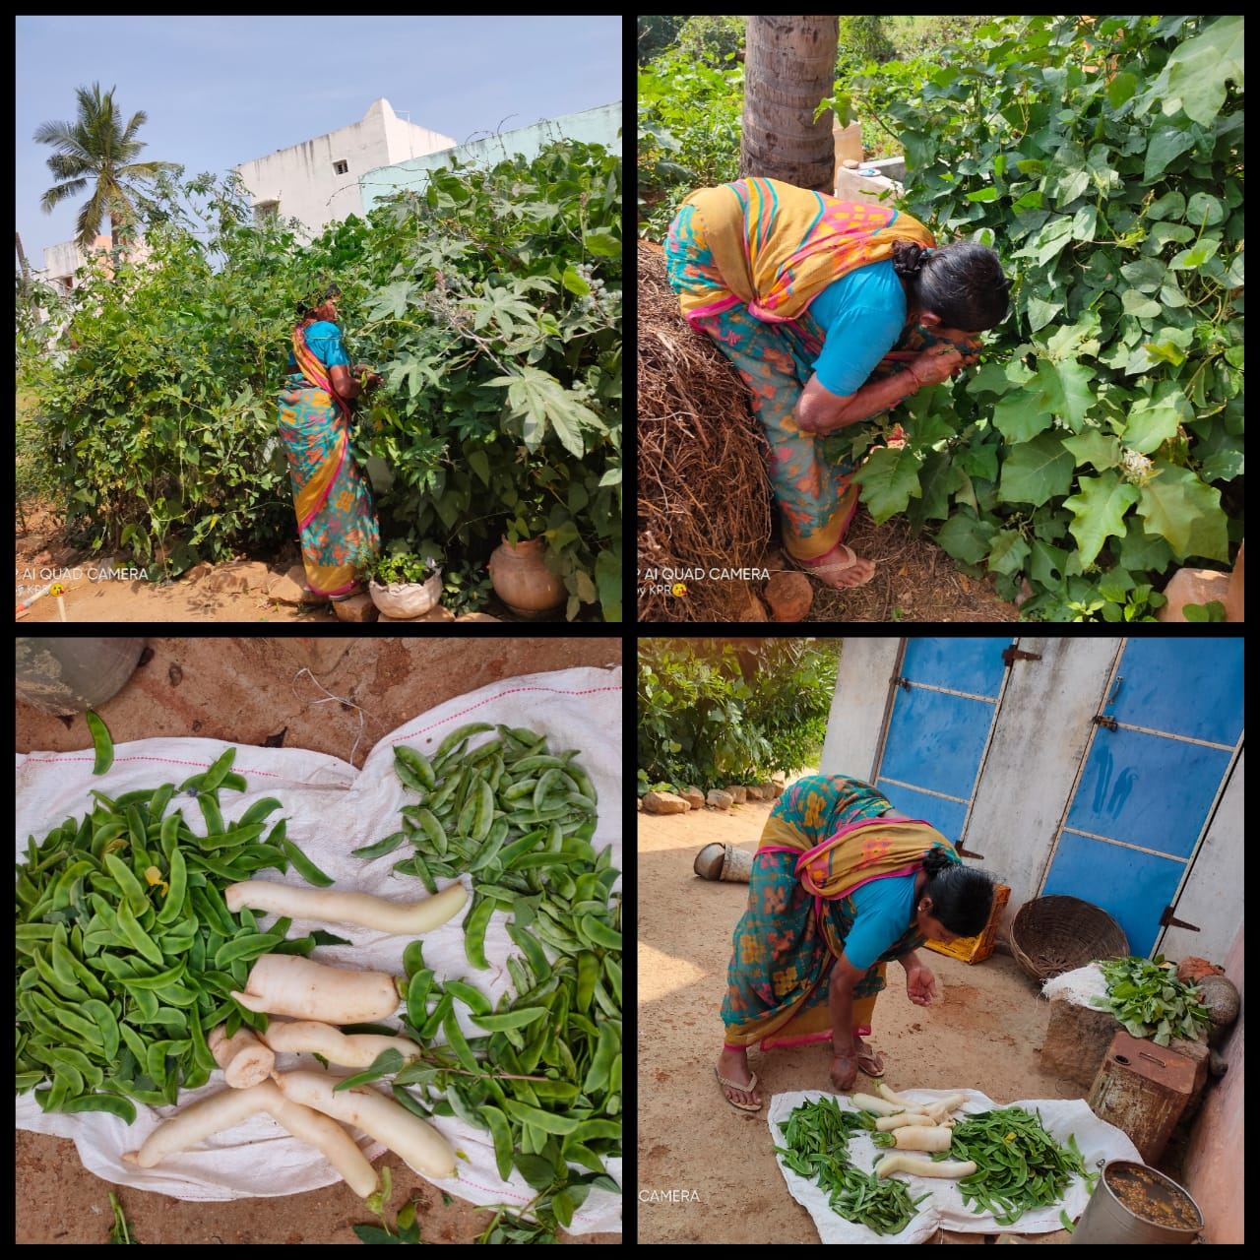
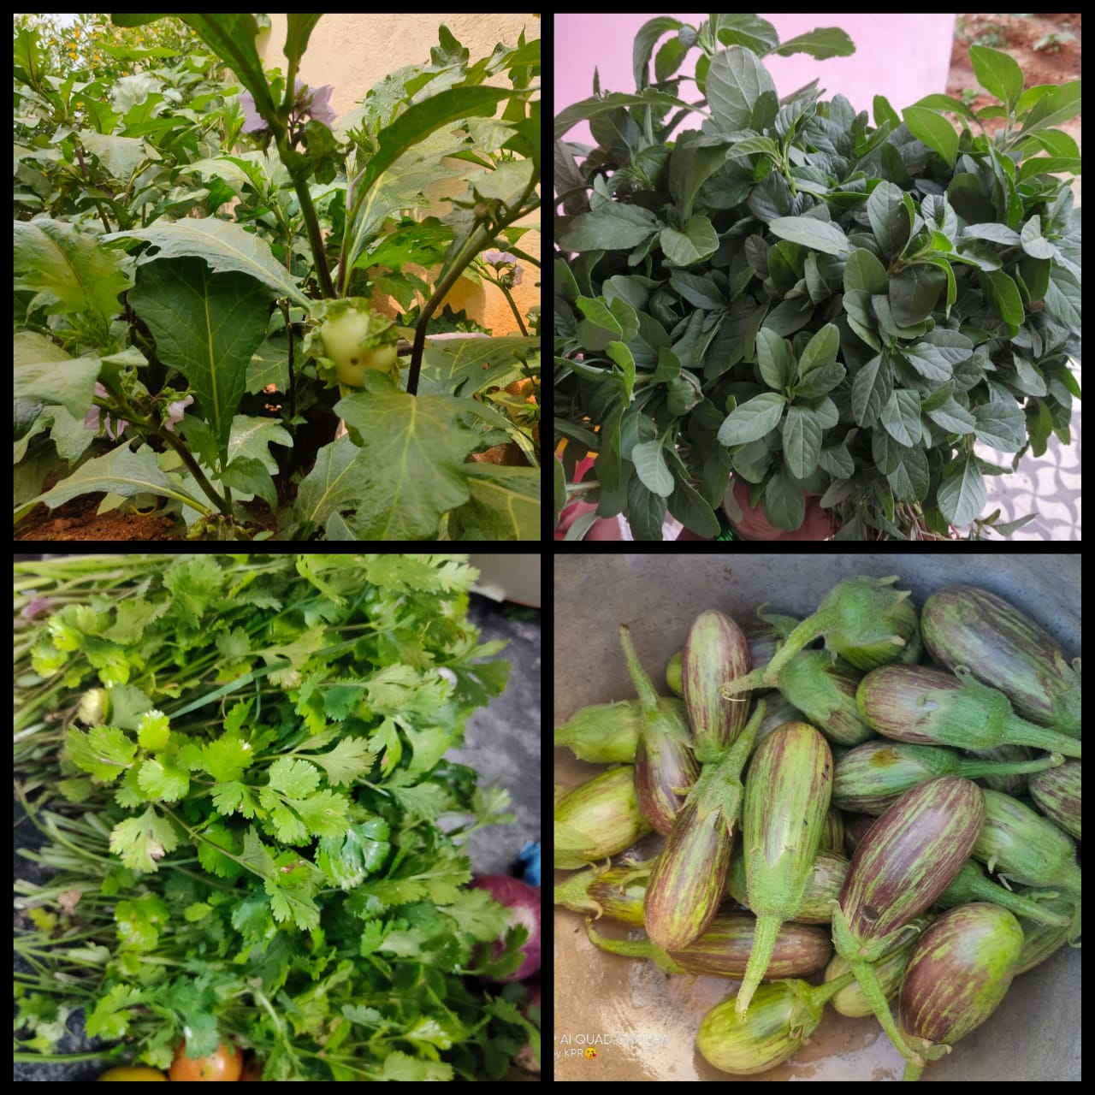
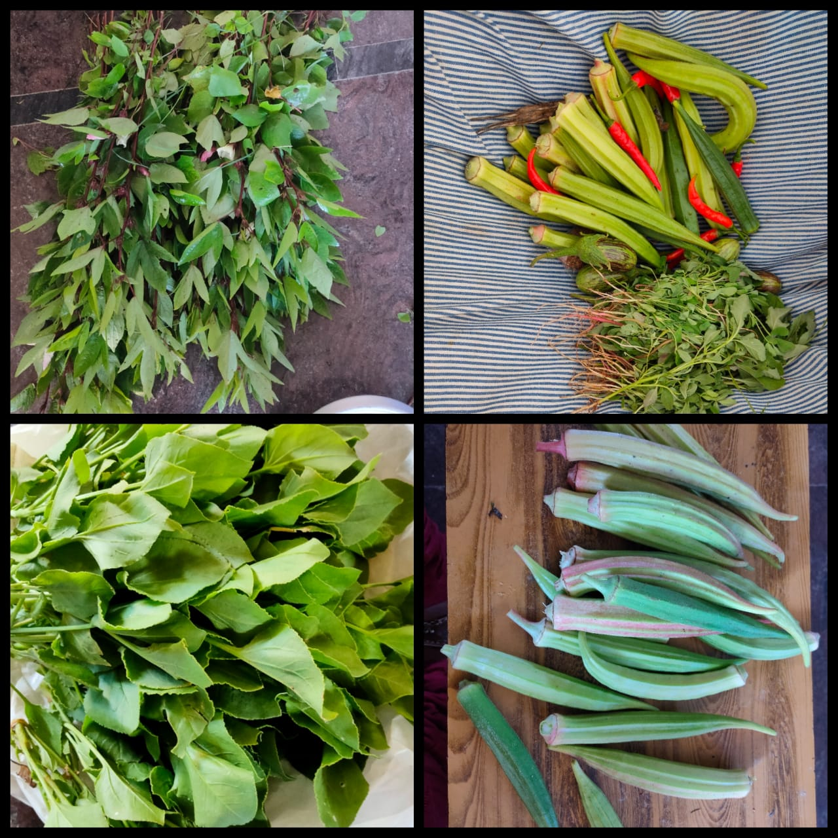
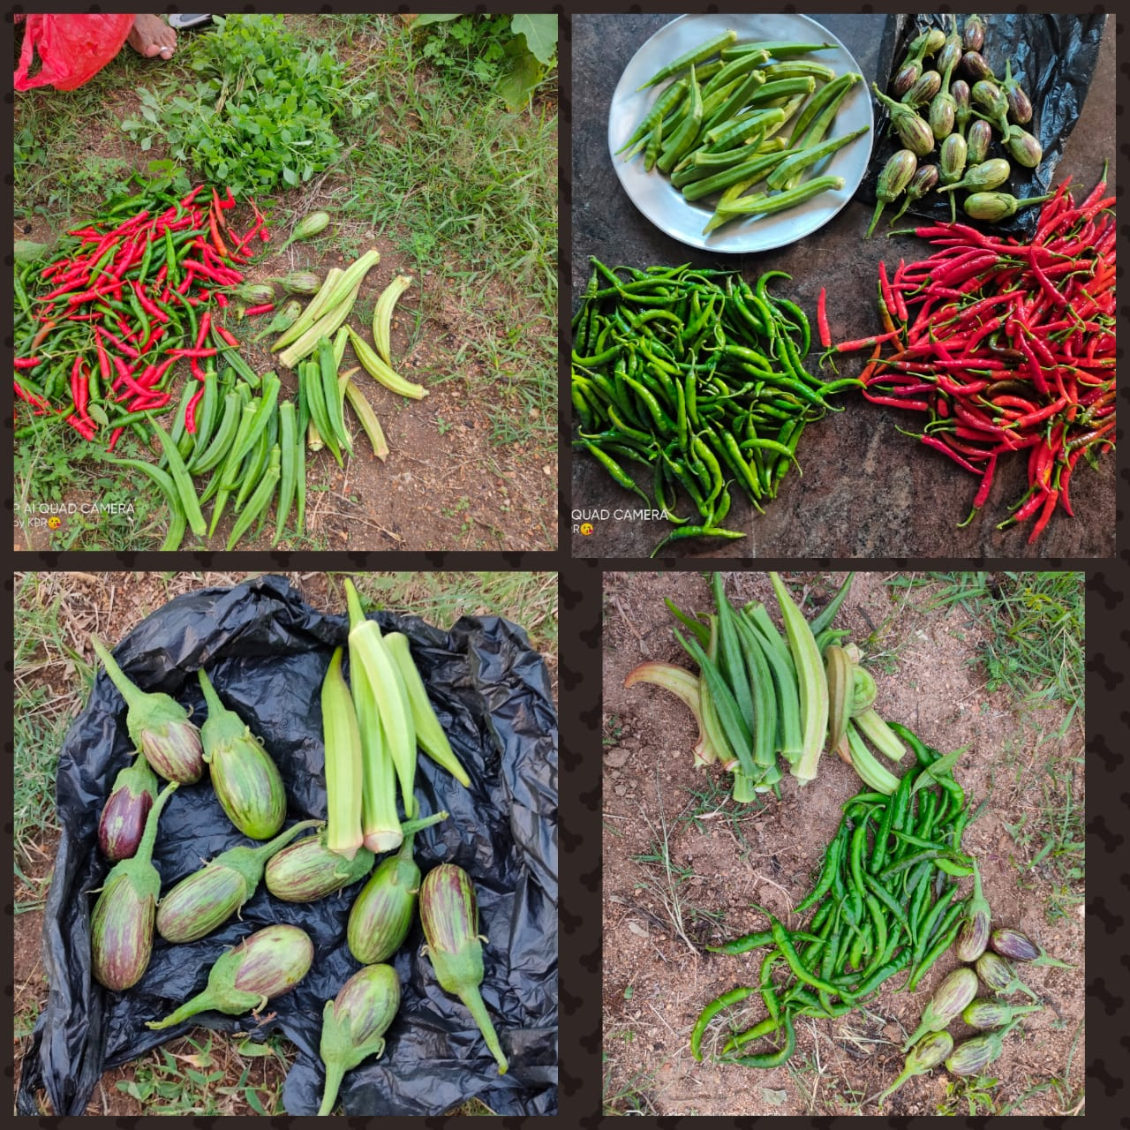
Veggies from Kitchen Garden

Slide 30
Bringing Diversification in the Tomato crop

Slide 31
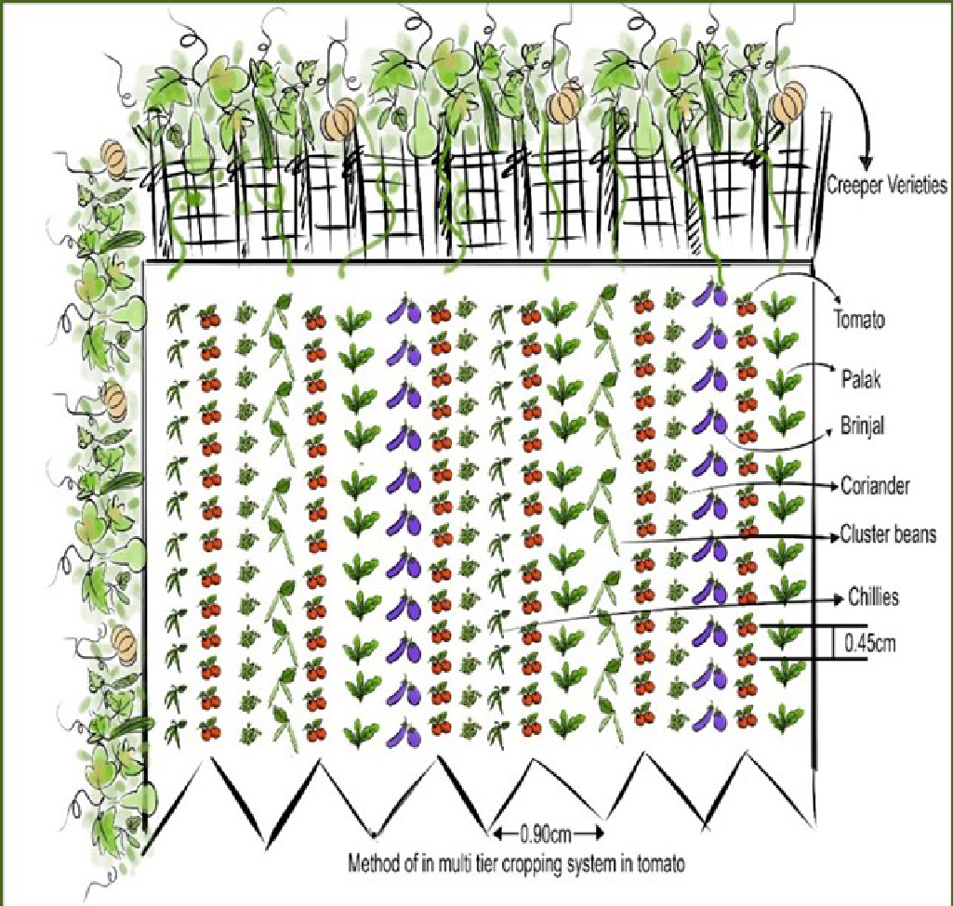
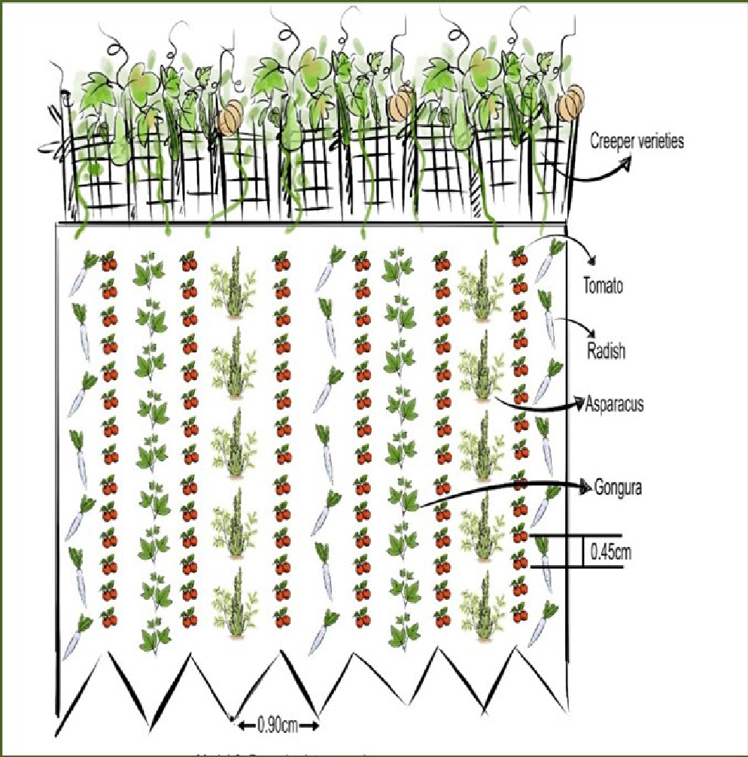
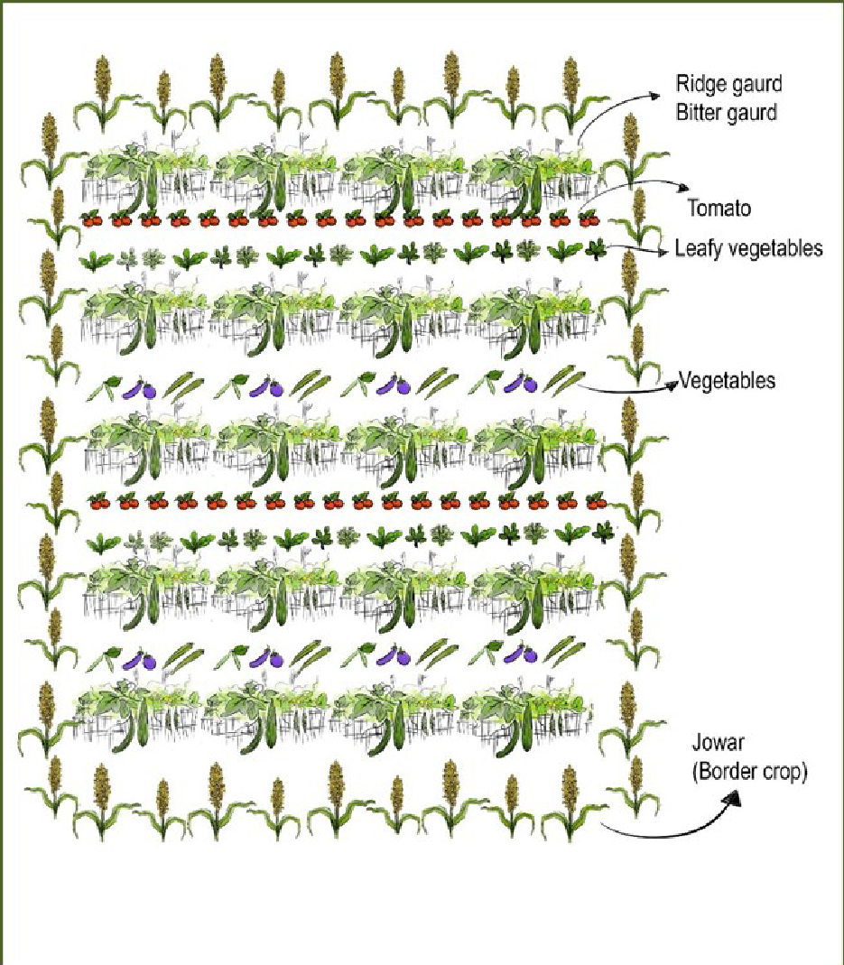
Model-1:Mixed Inter Cropping
Model-2:Row Inter Cropping
Model-3:Multi Crops Continuation
Tomato planting in the middle portion of the bed.15day after the leafy vegetables and vegetables are planting in the same beds(Side slops) with a distance of 45 cm. The creeper variety seeds are planting around the fields. In this way vegetables and leafy vegetables are planting 2 times till the end of the main crop.
As usual, the tomato is the main crop, but in this model, the tomato crop is grown in a row and next row the vegetable, leafy Vegetable crops growing simultaneously. and planting creeper varieties around the field.
The main crop is tomato, more than 5 varieties of vegetables, leafy vegetables are growing throughout the year and creeper varieties are growing as a continuation crop in the existing staking before tomato get uprooted

Slide 32
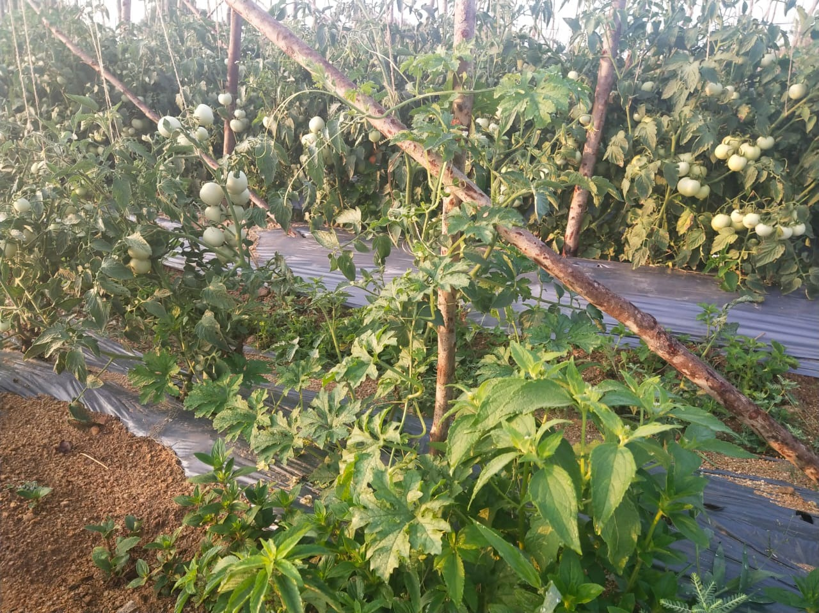
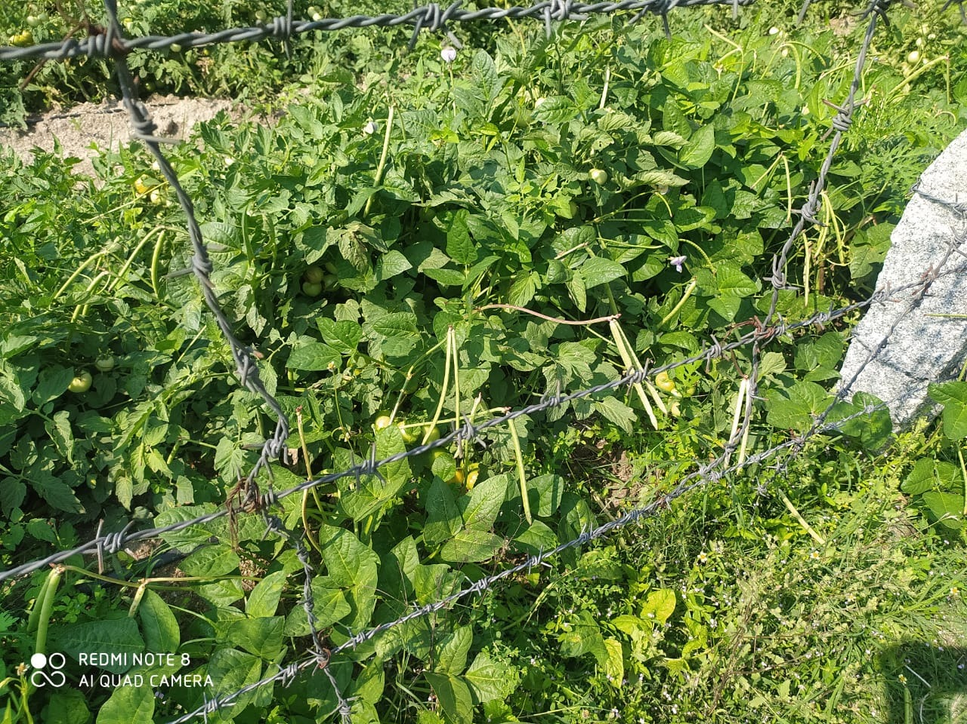
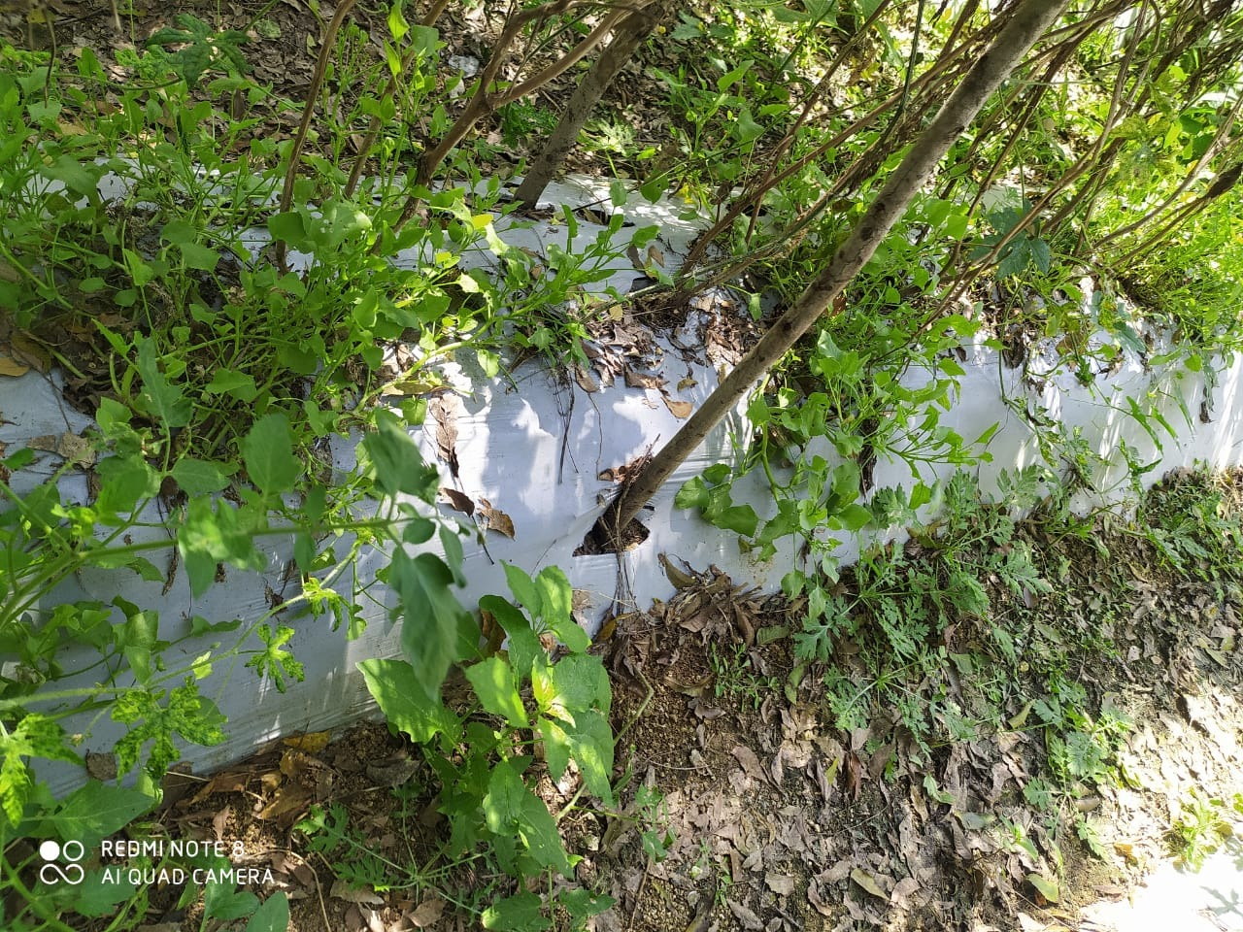
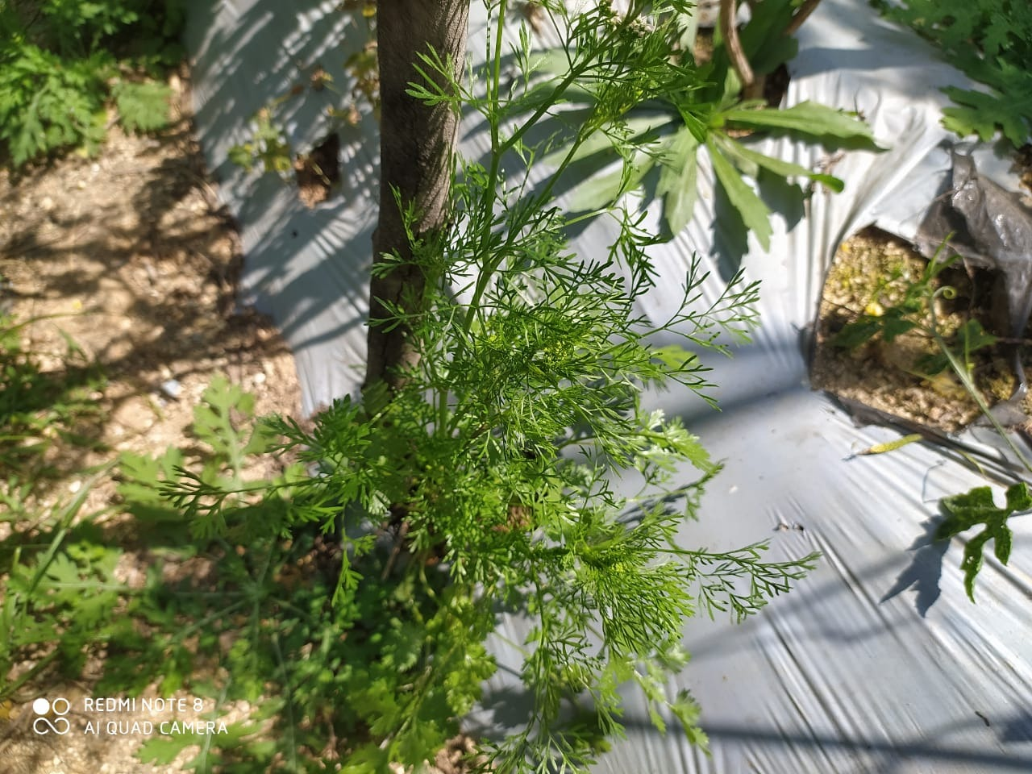
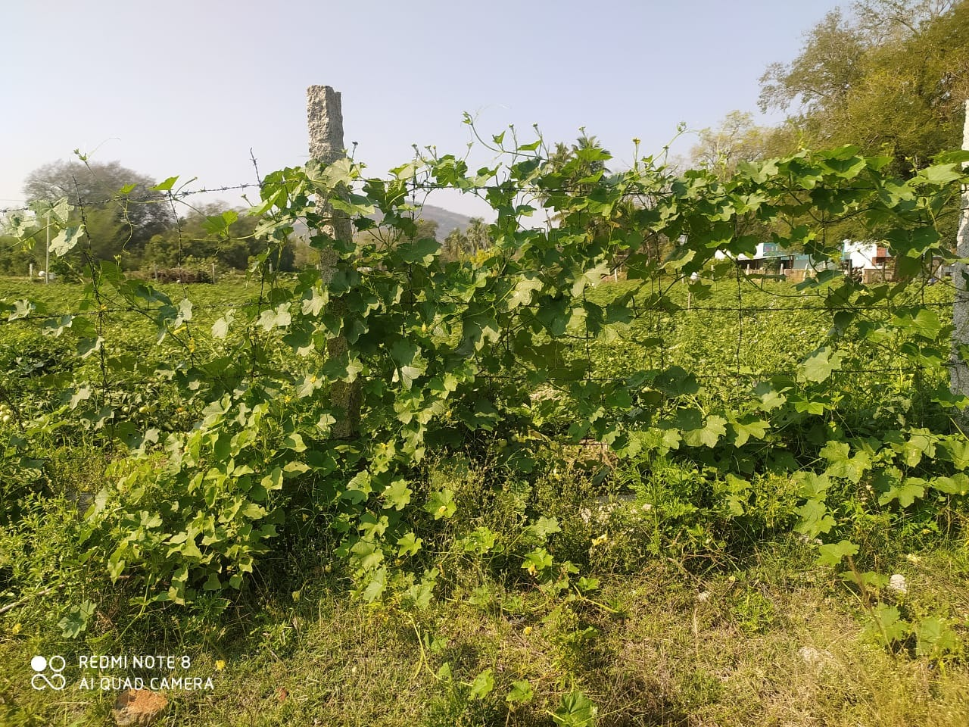
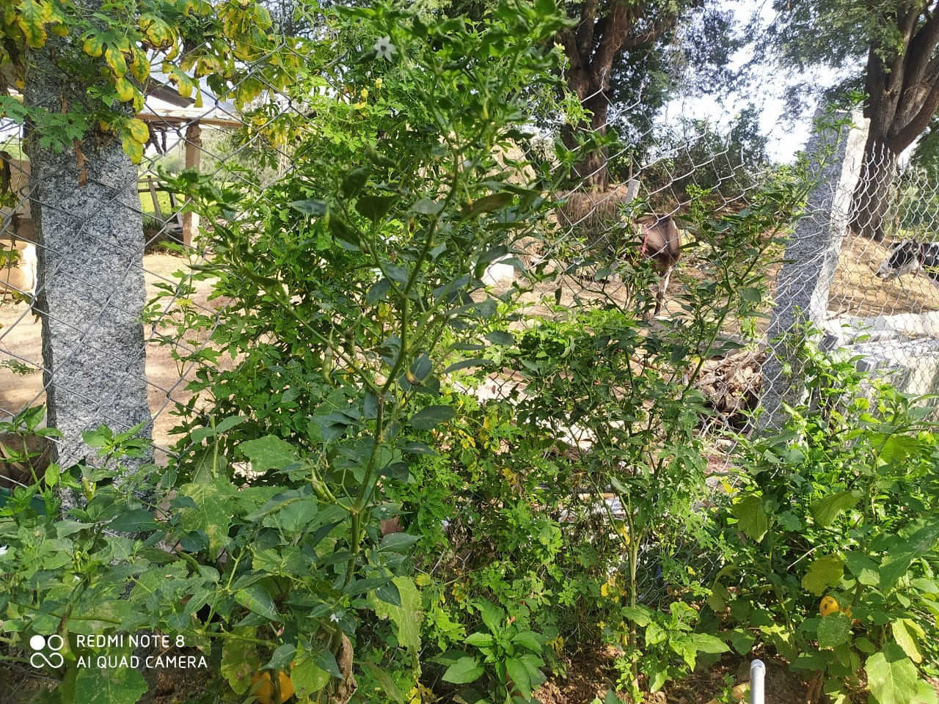
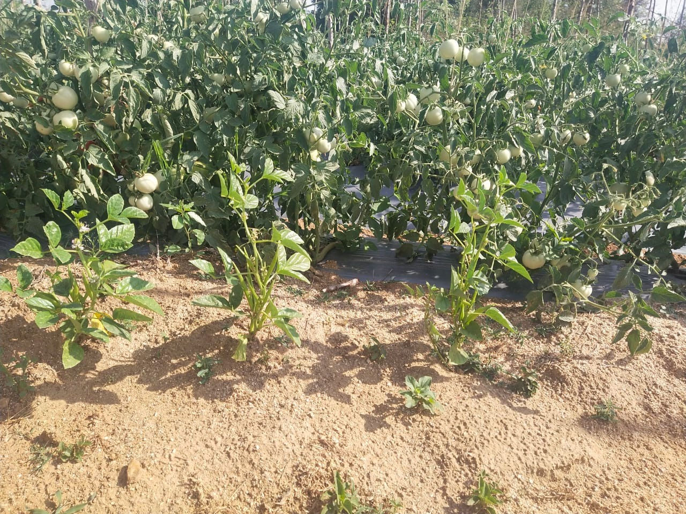
Main crop: Tomato
Leafy vegetables: Palak,Coriander
Vegetables: Chilly, Brinjal, Cluster beans
Creepers:
Cowpea
Ridge gourd

Slide 33
INTENSIVE TREES AND DESI POULTRY INTEGRATED FARMS
A Complete System of Agroecology with Nutrient Recycling

Slide 34
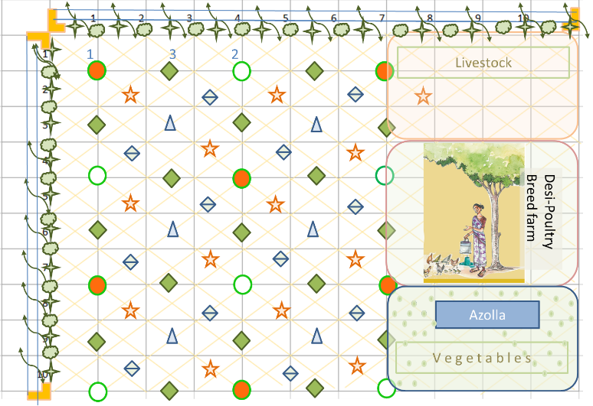
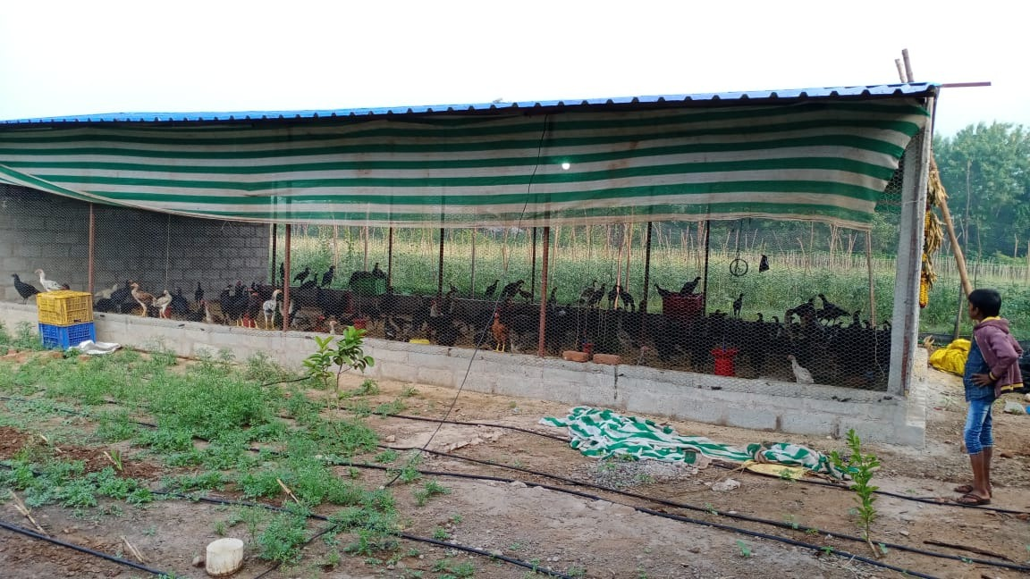
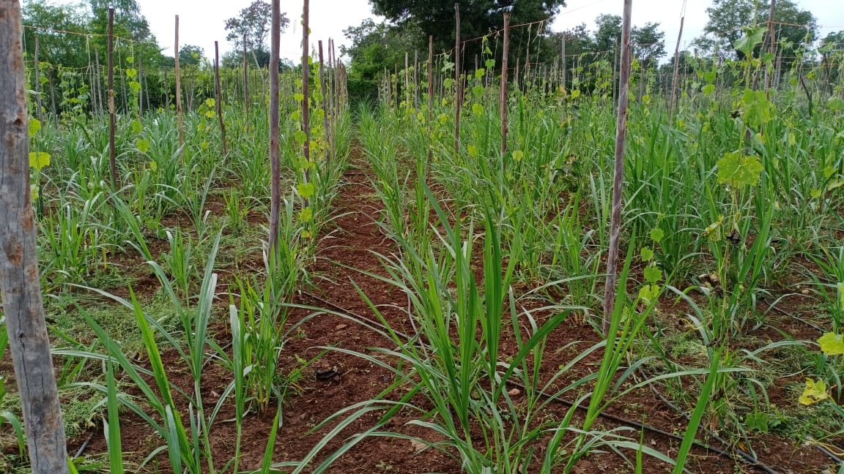
LIVESTOCK AND DESI BACKYARD POULTRY INTEGRATED INTENSIVE NATURAL FARM
Half acre to 0.75 ac farm,
Fenced
With a night shelter for poultry
5-layer intensive fruit and other trees, and grass
About 50 hen units- foraging
3 to 4 ram lambs (grazing)
2 Dairy animals.
Low irrigation through drips
Investment of about Rs.2.00 lakhs over period
Returns start from 6 months.
Reach about Rs.0.75 toRs.1.00 lakh by 2nd year
Pays back in 4 years time

Slide 35
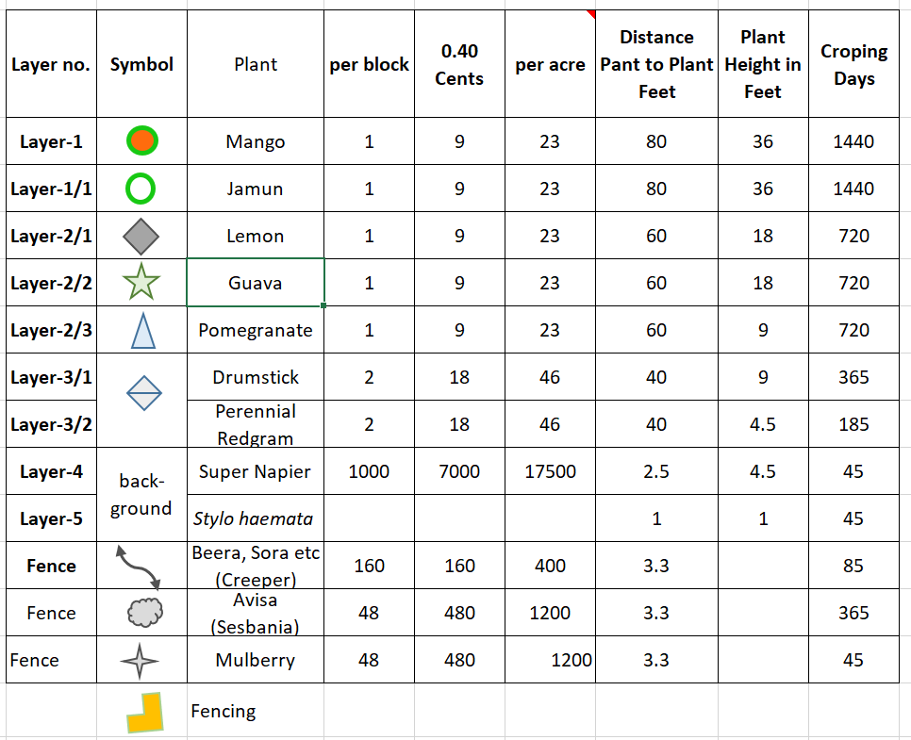
DIVERSE AND MULTI-LAYERED TREES

Slide 36
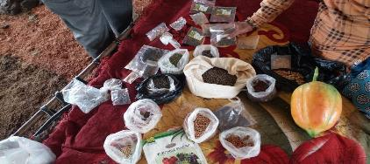
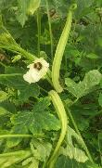
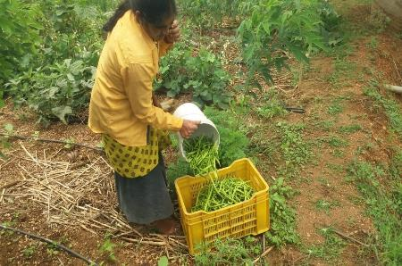
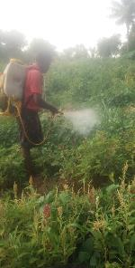
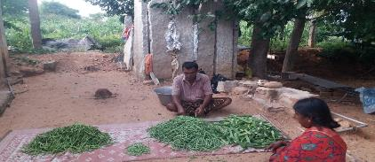
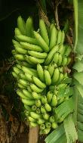
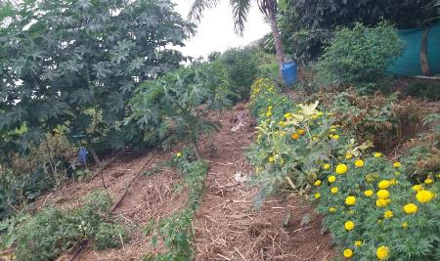
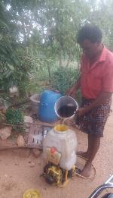
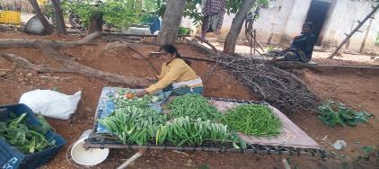
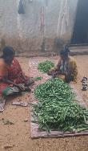

Slide 37
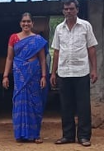
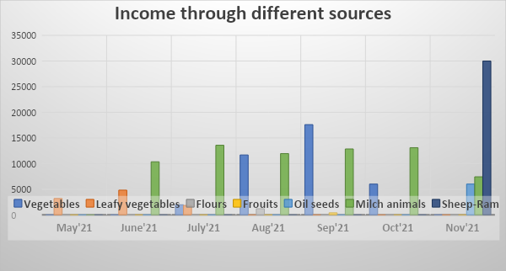
O.Yella Reddy experience
Sl.No | Particulars | May'21 | June'21 | July'21 | Aug'21 | Sep'21 | Oct'21 | Nov'21 | Total Value
1 | Vegetables | 0 | 0 | 1970 | 11680 | 17600 | 6000 | 0 | 37250
2 | Leafy vegetables | 3190 | 4820 | 1840 | 0 | 0 | 0 | 0 | 9850
3 | Flours | 0 | 0 | 0 | 1200 | 0 | 0 | 0 | 1200
4 | Fruits | 0 | 0 | 0 | 0 | 400 | 0 | 0 | 400
5 | Oil seeds | 0 | 0 | 0 | 0 | 0 | 0 | 6000 | 6000
6 | Milch animals | 0 | 10350 | 13575 | 11950 | 12850 | 13100 | 7425 | 69250
7 | Sheep-Ram | 0 | 0 | 0 | 0 | 0 | 0 | 30000 | 30000
 | TOTAL INCOME | 3190 | 15170 | 17385 | 24830 | 30850 | 19100 | 43425 | 153950

Slide 38
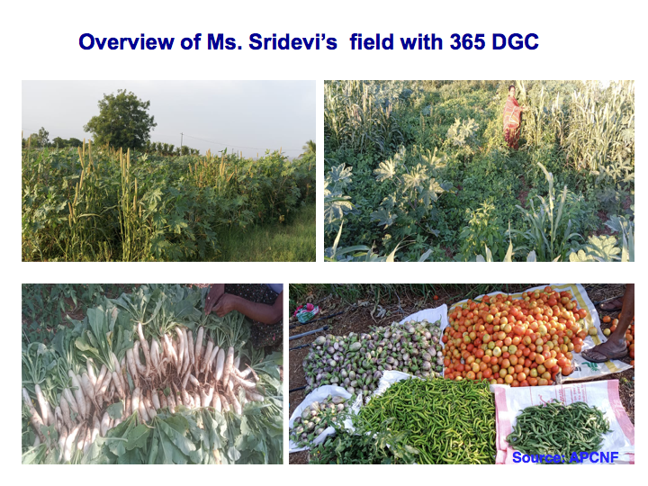
365 Days
Green Cover
Ananthapuram
Source:APCNF

Slide 39
Conclusions
Where: Food and Nutrition Security, Wheat, Rice, 52% Rainfed,
What: Location Specific Design
How: Awareness, Capacity building, Resource Access, Farmer led On-farm Research, Integration with GO, NGO, FN, Social Capital Building
When: Start Now
Why: Inclusiveness, Equity and Sustainability

Slide 40
365 DGC
Pre-moonsoon Dry Sowing (PMDS)
Seed pelletized with Ghanajeevamrutam, clay, and ash- covered with three inches of mulch
Relay cropping starts after PMDS in summer
400 kg ghanajeevamrutam is mandatory

